Slide 1
ELECTRICITY BILLING SYSTEM
done by,
Gokul ram

Slide 2
INTRODUCTION
The electricity billing system has been developed to override the problems prevailing in the practicing manual system. This software is supported to eliminate and in some cases reduce the hardship faced by this existing system. Moreover, this system is designed for the particular need of the company to carry out operations in a smooth and effective manner. The application is reduced as much as possible to avoid errors while entering the data it also provides error messages while entering invalid data. No formal knowledge is needed for the user to use this system. Thus by this, it proves it is a user-friendly electricity billing system, as described above, can lead to an error-free, secure, reliable and fast management system. It can assist the user to concentrate on their other activities instead concentrate on record-keeping thus it will help organizations in better utilization of resources. Every organization, whether big or small has challenges to overcome and manage the information of unit energy, electricity, store record, connection, electricity board, and every electricity billing system

Slide 3
SCOPE
IT SATISFY THE USER’S REQUIREMENT THINGS
BE EASY TO UNDERSTAND BY THE USER AND OPERATOR
BE EASY TO OPERATE
HAVE A GOOD USER INTERFACE
BE EXPANDABLE
DELIVERED ON SCHEDULE WITHIN THE BUDGET. WE HAVE TRIED TO MAKE SUCH TYPE OF SOFTWARE, WHICH SATISFY THE ABOVE GIVEN REQUIREMENT.

Slide 4
Flow chart
Entre Customer Details
Unit Consumed
No
Entre Valid Information
Bill Calculated Successfully

Slide 5
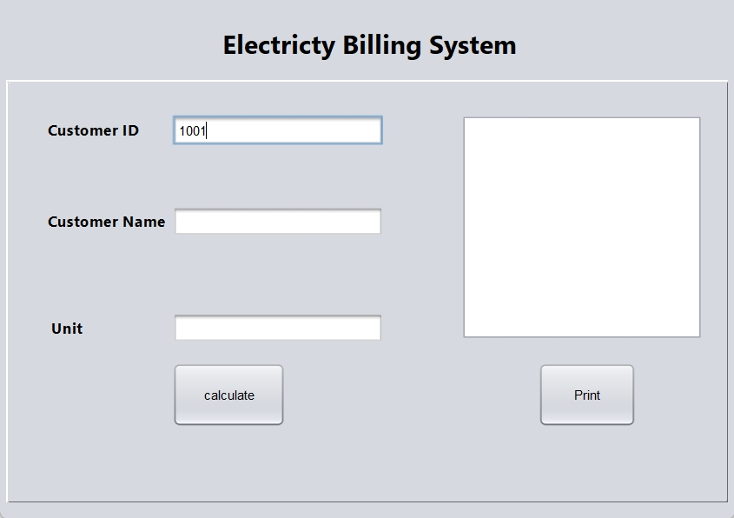
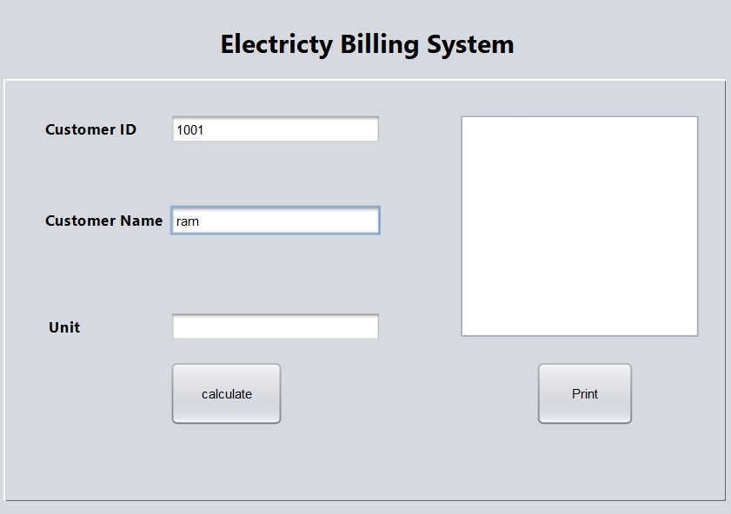
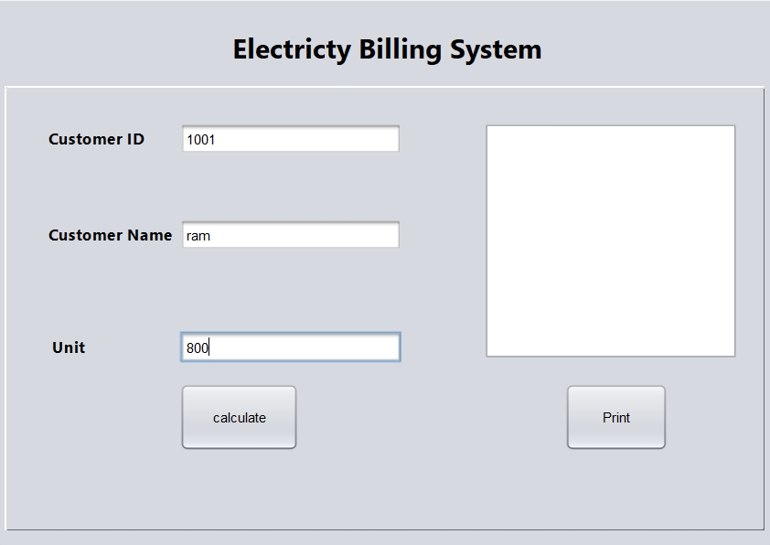

Slide 6
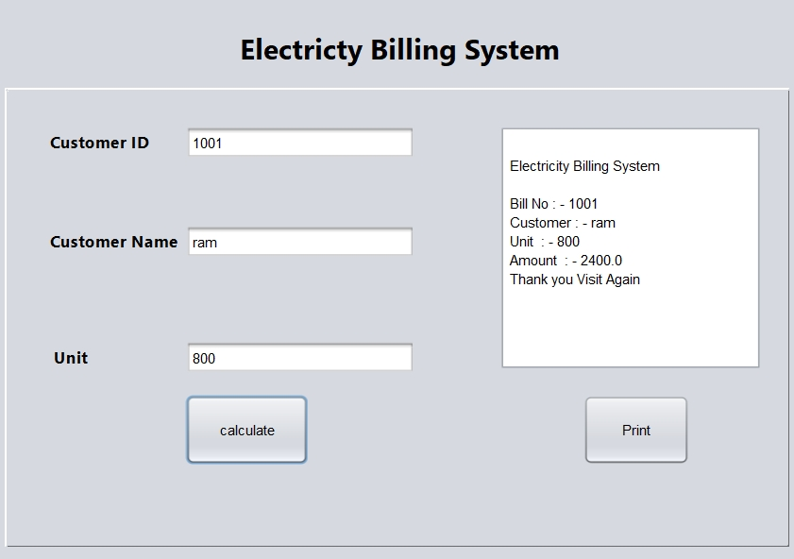
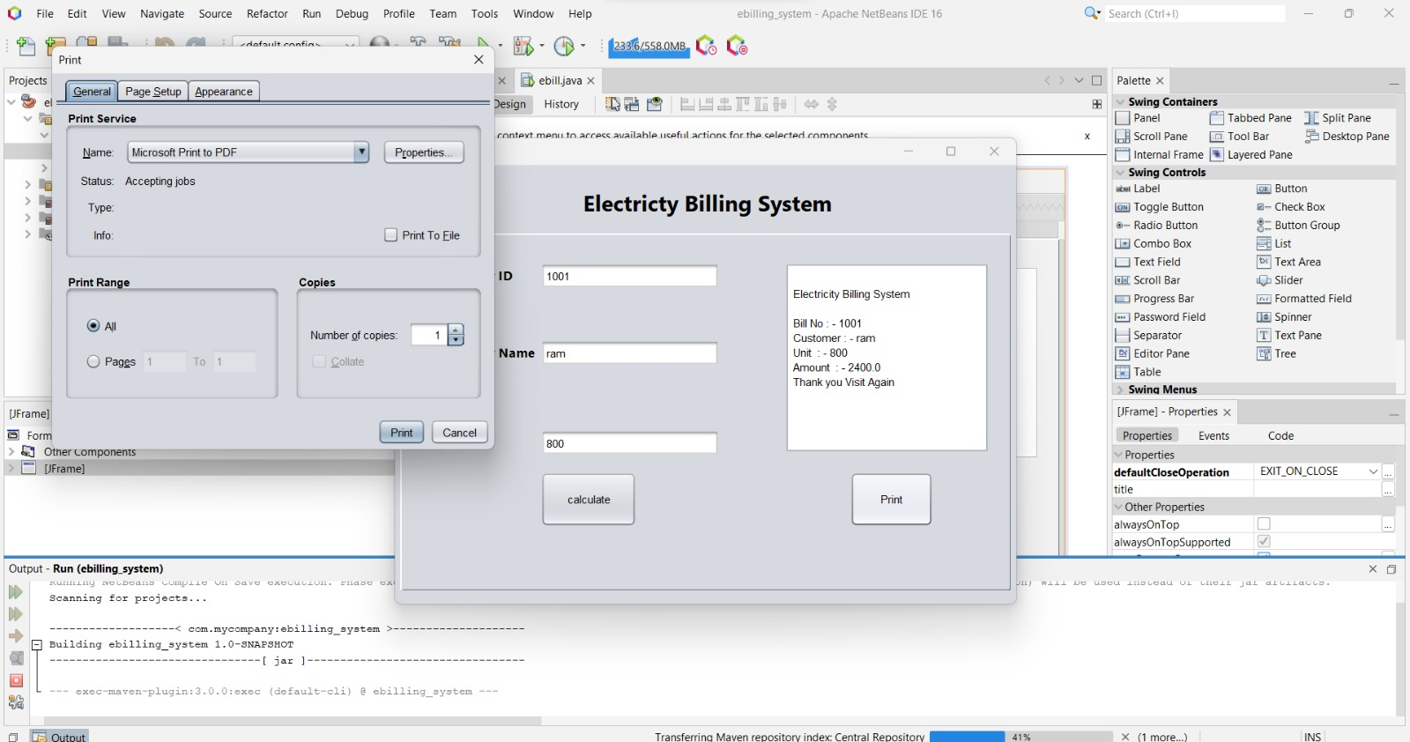

Slide 7
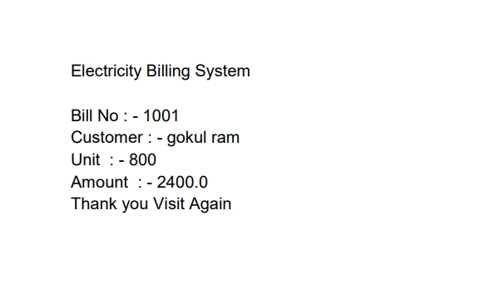
Output

Slide 8
Thank you……..

